Slide 1
Crop Production Analysis in India

Slide 2
Introduction
The agriculture business domain, a crucial part of the supply chain, is poised for significant evolution due to advancements in the Future Internet. This report introduces a novel Business-to-Business collaboration platform tailored for the agro-food sector, designed to enhance collaboration among various stakeholders effectively and flexibly. The dataset includes extensive information on crop production in India over several years, aiming to predict crop production and uncover key insights and metrics influencing it.

Slide 3
Problem Statement
The goal of this project is to improve stakeholder collaboration and optimize crop production in the agriculture sector. To achieve this, we introduce a novel Business-to-Business collaboration platform for the agro-food sector. We used an extensive dataset on crop production in India spanning several years. The objective is to apply data analysis and visualization techniques to predict crop yields and uncover key indicators and metrics influencing production. This project aims to use Business Intelligence tools such as Tableau or Power BI to gain valuable insights from the data.

Slide 4
Main KPIs
Total Area
Total Production
Average Yield
Total Area

Slide 5
Insights
● Production Trend
● Yield Trend
● Crops With Best Yield Value
● Most produced Crops
● Production by season of a crop
● States with Most Production
● Top 5 Crops by Area for Production
● Area vs Production base by Season
● Sum of Area and Sum of Production by State_Name

Slide 6
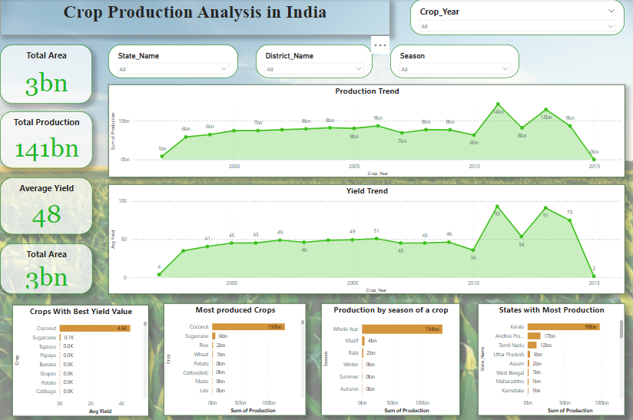
My Design
Page 1

Slide 7
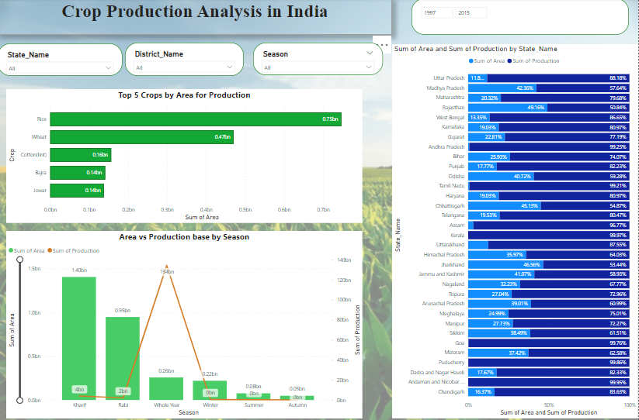
Page 2

Slide 8
Thank you

